Slide 1
Fatigue, Drugs and Alcohol
National Mine Safety Week
Notes:
Welcome.
Introduce yourself.

Slide 2
Introduction
Fatigue is a physical condition that occurs when a person’s physical or mental limits are reached.
Fatigue can reduce performance and productivity and can increase the risk of incidents and injury.
Ok Tedi recognises that a person’s fitness for work can be adversely affected by many factors including:
Fatigue
Inappropriate use of alcohol
Use of illicit drugs
Some prescribed medications.

Slide 3
What Causes Fatigue?
Major factors contributing to, and increasing the risk, of fatigue include:
Insufficient good quality sleep
General fitness issues (poor diet, dehydration, lack of exercise)
Stress or anxiety
Work conditions (poor ventilation or lighting, monotonous or repetitive work, irregular and/or unpredictable working hours)
Some medical conditions and medications.
Fatigue can:
Be caused by alcohol and/or drug use
Be worsened by alcohol and/or drug use
Lead to increased alcohol and/or drug use.

Slide 4
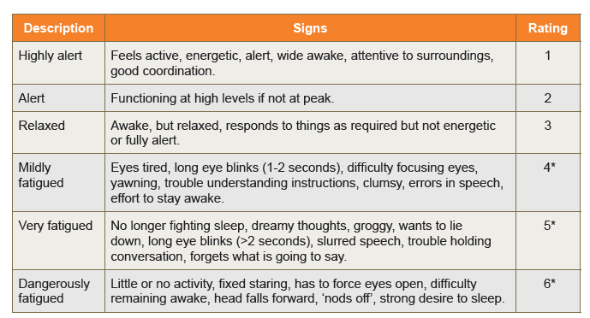
Signs & Symptoms of Fatigue
*** Individuals with ratings 4, 5, and 6 should not operate plant and equipment

Slide 5
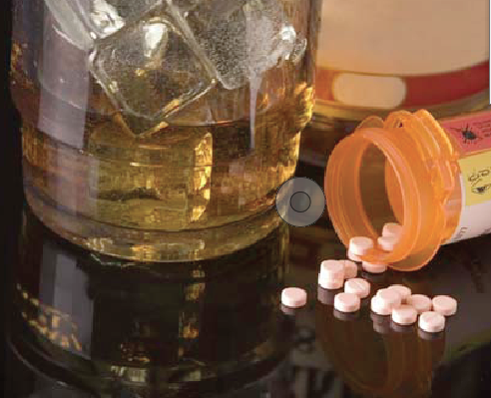
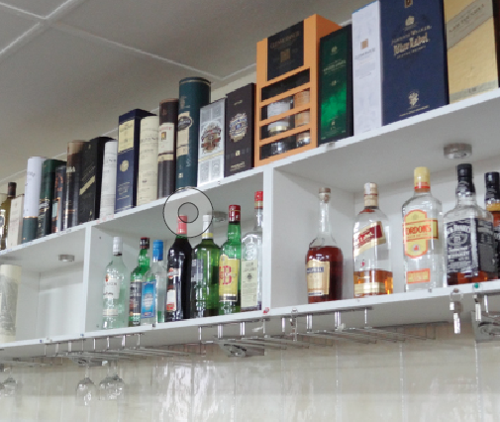
Alcohol, Illicit Drugs, Prescribed Medications
Ok Tedi has a Zero tolerance policy for alcohol and illicit drug use in the workplace.
All employees, contractors and visitors must have a 0.00 breath alcohol concentration and a confirmed negative drug test result.
Alcohol and drugs include:
All substances containing alcohol
Drugs such as amphetamines, barbiturates, benzodiazepines, cannabinoids, cocaine, LSD, methadone
Opiates including over-the-counter and prescription medication
Betel nut.

Slide 6
Alcohol
Alcohol is a depressant that increases sleepiness. However, it can also disrupt sleep and reduce sleep quality.
1-2 standard drinks may help workers fall asleep faster.
5 or more drinks will increase their chances of waking early when the most restful sleep occurs.
Alcohol reduces the dreaming stage of sleep which is important for memory, learning and regulating nervous system activity and mood.
It also increases daytime sleepiness and physical and mental impairment in someone who is already fatigued.

Slide 7
Drugs
Drug use can also affect fatigue. Workers may use over the counter (OTC), prescribed, and/or illicit drugs to:
Overcome the effects of fatigue to meet work, social, and family commitments
Treat other medical conditions and experience fatigue as a side-effect
Counteract feelings of fatigue when they are ‘coming down’ or withdrawing from drug use.

Slide 8
How do drugs affect sleep?
Betel Nut:
Chewing betel nut can lead to a dependence and an increased tolerance, meaning you will need more to feel the same effects
Opiods (including over the counter pain medication):
Can mask a more serious underlying condition.
Side effects of chewing betel nut include altered speech, increased sensitivity to heat and cold, high blood pressure, mood swings, irritability, anxiety, loss of concentration and disturbed sleep.
Affects sleep patterns and reduces the quality and amount of sleep.
Other drugs (including methamphetamine, cocaine, cannabis):
Methamphetamine disrupts brain chemistry and prevents sleep, sometimes for several days. Can also cause depression and anxiety
Other drugs can cause strange dreams and insomnia.

Slide 9
Drug & Alcohol Testing
Ok Tedi has a ZERO TOLERANCE policy for alcohol and illicit drug use in the workplace.
All employees, contractors and visitors must have a 0.000 breath alcohol concentration and a confirmed negative drug test result.
Ok Tedi employs suitably trained and authorised personnel to collect breath specimens for alcohol screening, and saliva and urine samples for drug screening.
Drug and alcohol testing is carried out:
As part of the pre-employment health assessment
When there is reasonable grounds to suspect a problem consistent with the use of drugs or alcohol
Following a reportable accident or incident
On a random basis in accordance with Ok Tedi procedures.
Individuals who are being tested are allowed to have a witness present.
Any person working or visiting an Ok Tedi site may be tested at any time without notice.

Slide 10
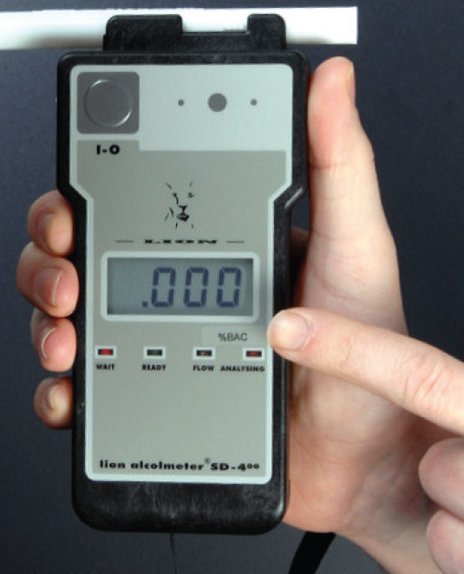
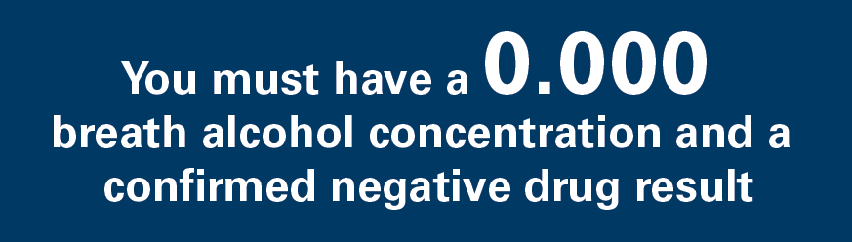
Drug & Alcohol Testing
Breath test for alcohol:
If a positive result is obtained from a breath test, a confirmatory test is performed after a 20 minute interval
If the second test is positive, both tests are recorded and treated as a positive result
If the second test is negative, the individual is cleared for work
Saliva test for drugs:
If a positive result is obtained from a saliva test then a confirmatory test is performed using a urine sample
Tampering:
If you tamper with test samples or results you will be summarily dismissed

Slide 11
Self- Test Kits
Alcohol
Breath analysis self-testing equipment is accessible
If a positive reading results from the self-test, advise your supervisor immediately that you cannot commence work
The test will not result in disciplinary action provided that the self-test was undertaken before entering the main gates and starting work
If you self-test after starting work and a positive reading is obtained then disciplinary action may be taken
Drugs
Self-test drug kits can be purchased at the employee’s own expense

Slide 12
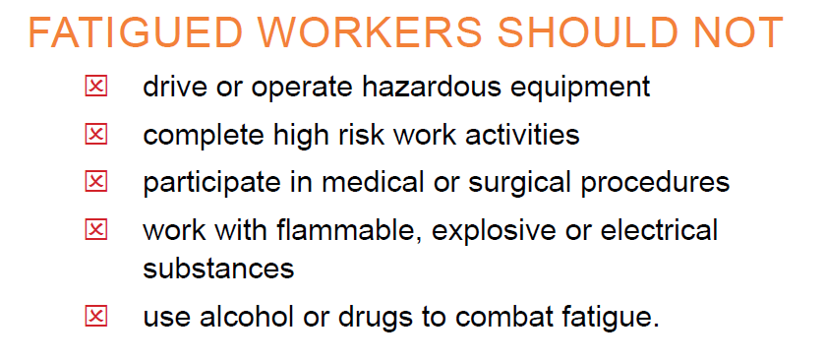
Summary

Slide 13
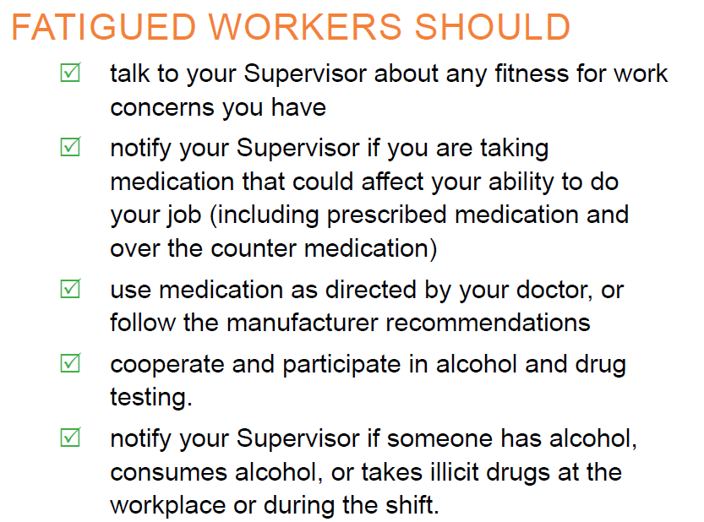
Summary
Remember OTML has a Zero Policy for drug and alcohol use at work.

